Slide 1



SENTIENT SENTENCE SENSE-AIs
SIOP MACHINE LEARNING COMPETITION 2023

Slide 2
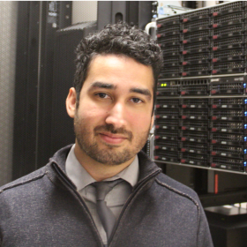



THE TEAM
Ivan Hernandez
Virginia Tech
Andrew Cutler
Sama Therapeutics
Joe Meyer
Erudit & UCSC
Weiwen Nie
Hogan Assessments
Project Language: Python (numpy, pandas) via Jupyter Notebooks
Coding Environments: Google Colab, Virginia Tech Compute Cluster
Machine Learning Packages: Scikit-learn Deep Learning Packages: Huggingface, Sentence-Transformers, Keras, KerasTuner
Communication/Coordination: Discord, Zoom
Notes:
Hello everyone. My name is Ivan Hernandez. I’m an assistant professor at Virginia Tech, and presenting on behalf of the team.
On the team we have Andrew Cutler, a computer science graduate from Boston University who works at Sama Therapeutics.
Joe Meyer from Erudit who many of you in this room know from the *many* symposia on NLP he’s chaired throughout the past few years including one this Saturday at 12:30. He also teaches an online NLP course at UCSC for those interested in learning more NLP.
Weiwen who works for Hogan Assessments who is in Exhibit Hall next to registration if you wanted to see the cutting edge work they do with personality. You can see Weiwen at the NLP symposium on Saturday as well, and he is also part of the Friday at 9am on the causes and outcomes of self–other (dis)agreement in 360-degree assessments.
As as team, we all worked in Python using Jupyter notebooks for most of our code.
Our notebooks were mostly hosted on Colab or on the Virginia Tech Compute Cluster
For the machine learning aspect of our solution, we use the scikit learn library
For NLP the Huggingface, Sbert
For Deep learning we used Keras
And to coordinate we used a combination of Discord for day-to-day communication, and Zoom for progress updates.

Slide 3
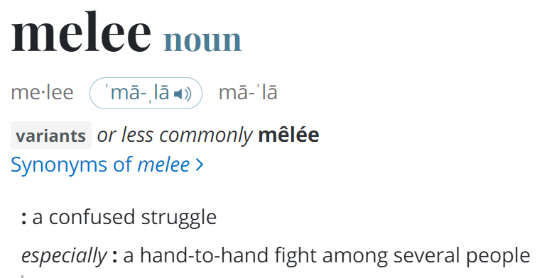
ONE SOLUTION TO THE PROBLEM
Multi-
Embedding
LSTM
Ensemble of Ensembles
Notes:
Our solution to the problem can be summarized as a multiembedding LSTM ensemble of ensembles, which I’ll refer to as MELEE for simplicity
Melee is defined as a confused struggle amongst between many people, which is a very apt descriptor of not only the machine competition, but also describes really well conceptually how our solution to the competition works

Slide 4
CONCEPTUAL OVERVIEW OF MELEE
Multi-Embedding LSTM Ensemble of Ensembles (MELEE)
Stage 1: Get Different Perspectives on the Exercise Responses
A single embedding model is attuned to specific aspects
Embed each response with a single embedding model
Use LSTM to figure out how embedding sequence relates to the outcomes
Repeat using different embedding models to pick up on some things other models do not
Stage 2: Weight Each Perspective Appropriately in Different Ways
Ensemble the predictions of the different LSTMs to predict the 7
outcomes even better
Vary:
The combination/grouping of LSTMs
Type of ensembling method (Ridge, Random Forest, etc.)
Stage 3: Aggregate the Ensembles to Optimize Specific Outcomes
Record Dev performance of ensembles from Step 2 for each Outcome
Average predictions of Best Performing Ensembles for each Outcome
Notes:
Here is the MELEE approach from a conceptual point of view

Slide 5
CONCEPTUAL OVERVIEW OF MELEE
Multi-Embedding LSTM Ensemble of Ensembles (MELEE)
Stage 1: Get Different Perspectives on the Exercise Responses
A single embedding model is attuned to specific aspects
Embed each response with a single embedding model
Use LSTM to figure out how embedding sequence relates to the outcomes
Repeat using different embedding models to pick up on some things other models do not
Stage 2: Weight Each Perspective Appropriately in Different Ways
Ensemble the predictions of the different LSTMs to predict the 7
outcomes even better
Vary:
The combination/grouping of LSTMs
Type of ensembling method (Ridge, Random Forest, etc.)
Stage 3: Aggregate the Ensembles to Optimize Specific Outcomes
Record Dev performance of ensembles from Step 2 for each Outcome
Average predictions of Best Performing Ensembles for each Outcome
Notes:
A key part of MELEE is being able to get different perspectives on what people said
You know that sentence embeddings offer a way to quantify what text describes along different dimensions
A single embedding model is going to attuned to a subset of specific aspects
So we’ll embed each of the in-basket responses with a single embedding model
Then we’ll send that sequence of embeddings to a Long Short Term Memory model, which are great at figuring out how a sequence of vectors combine to form an outcome
We’ll repeat this process using different embedding models, which will each pick up on things that other embedding models do not

Slide 6
CONCEPTUAL OVERVIEW OF MELEE
Multi-Embedding LSTM Ensemble of Ensembles (MELEE)
Stage 1: Get Different Perspectives on the Exercise Responses
A single embedding model is attuned to specific aspects
Embed each response with a single embedding model
Use LSTM to figure out how embedding sequence relates to the outcomes
Repeat using different embedding models to pick up on some things other models do not
Stage 2: Weight Each Perspective Appropriately in Different Ways
Ensemble the predictions of the different LSTMs to predict the 7
outcomes even better
Vary:
The combination/grouping of LSTMs
Type of ensembling method (Ridge, Random Forest, etc.)
Stage 3: Aggregate the Ensembles to Optimize Specific Outcomes
Record Dev performance of ensembles from Step 2 for each Outcome
Average predictions of Best Performing Ensembles for each Outcome
Notes:
Now that we have different LSTM models trained, each with their own perspective, some of those perspectives will capture only a piece of the rules for how the exercises were collectively scored
We’ll ensemble the predictions of the different LSTMs to learn how to weight each perspective
Because some perspectives might combine better than others and in different ways, we’ll vary the LSTMs that we combine as well as type of ensembling method used

Slide 7
CONCEPTUAL OVERVIEW OF MELEE
Multi-Embedding LSTM Ensemble of Ensembles (MELEE)
Stage 1: Get Different Perspectives on the Exercise Responses
A single embedding model is attuned to specific aspects
Embed each response with a single embedding model
Use LSTM to figure out how embedding sequence relates to the outcomes
Repeat using different embedding models to pick up on some things other models do not
Stage 2: Weight Each Perspective Appropriately in Different Ways
Ensemble the predictions of the different LSTMs to predict the 7
outcomes even better
Vary:
The combination/grouping of LSTMs
Type of ensembling method (Ridge, Random Forest, etc.)
Stage 3: Aggregate the Ensembles to Optimize Specific Outcomes
Record Dev performance of ensembles from Step 2 for each Outcome
Average predictions of Best Performing Ensembles for each Outcome
Notes:
Now that we have different ensembles trained, we can further optimize the predictions by combining the ensembles together that work best for specific outcomes
By examining the dev performance of each ensemble, we can know which ensembles are more suited for one outcome over another
We’ll have the best set of ensembles for a given outcome make predictions on the test set
And then we’ll average those predictions together.

Slide 8
WHY MELEE?
THE MELEE APPROACH OFFERS MANY ADVANTAGES
Good for multi-text datasets with a single outcome
More memory efficient than joining texts together
LSTMs can figure out how short sequences combine to make final score
Combining embeddings gives optimal attention
Good for smaller sized datasets
Do not need to train entire language model
All embeddings used a pre-trained
Only need to estimate LSTM regressor parameters
Good for multi-text problems with missing data
LSTMs naturally handle missing elements in a sequence
Use masking to indicate missingness
Good for multi-outcome problems
Have a choice of different ensembles
Can specialize in different outcome variables
Notes:
The way that MELEE works offers many advantages that align with the nuances of this particular competition

Slide 9
WHY MELEE?
THE MELEE APPROACH OFFERS MANY ADVANTAGES
Good for multi-text datasets that have an overall score(s)
More memory efficient than joining texts together
LSTMs can figure out how short sequences combine to make final score
Combining embeddings gives optimal attention
Good for smaller sized datasets
Do not need to train entire language model
All embeddings used a pre-trained
Only need to estimate LSTM regressor parameters
Good for multi-text problems with missing data
LSTMs naturally handle missing elements in a sequence
Use masking to indicate missingness
Good for multi-outcome problems
Have a choice of different ensembles
Can specialize in different outcome variables
Notes:
MELEE works great for datasets containing many texts from a given person responding in different contexts
Because it uses LSTMs to process the sequence of responses, it is more memory efficient than transformer models with long context windows
LSTMs are great at understanding how sequences combine, allowing us to reverse engineer scoring schemes
Most importantly, because no single embedding model will have its attention perfectly calibrated to a given exercise or to a given outcome, this approach uses the combination of different embedding models to take the best parts of each, finding the optimal attention when ensembled

Slide 10
WHY MELEE?
THE MELEE APPROACH OFFERS MANY ADVANTAGES
Good for multi-text datasets with a single outcome
More memory efficient than joining texts together
LSTMs can figure out how short sequences combine to make final score
Combining embeddings gives optimal attention
Good for smaller sized datasets
Do not need to train entire language model
All embeddings used a pre-trained
Only need to estimate LSTM regressor parameters
Good for multi-text problems with missing data
LSTMs naturally handle missing elements in a sequence
Use masking to indicate missingness
Good for multi-outcome problems
Have a choice of different ensembles
Can specialize in different outcome variables
Notes:
MELEE is great for smaller sizes datasets
Attention mechanisms take up a large amount of parameters.
MELEE emphasizes pre-trained transformers whose weights are all frozen.
We are embracing the imperfection of single embedding models as a strength rather than something that needs to be fine tuned away
The only parameters we are estimating are an LSTM regressor that processes the 17 inputs, which is extremely small by today’s standards

Slide 11
WHY MELEE?
THE MELEE APPROACH OFFERS MANY ADVANTAGES
Good for multi-text datasets with a single outcome
More memory efficient than joining texts together
LSTMs can figure out how short sequences combine to make final score
Combining embeddings gives optimal attention
Good for smaller sized datasets
Do not need to train entire language model
All embeddings used a pre-trained
Only need to estimate LSTM regressor parameters
Good for multi-text problems with missing data
LSTMs naturally handle missing elements in a sequence
Use masking to indicate missingness
Good for multi-outcome problems
Have a choice of different ensembles
Can specialize in different outcome variables
Notes:
MELEE is suited for multi-text problems with missing data
LSTMs naturally handle missing elements in a sequence
They can accept “masks” or vectors of all zeros to indicate that a timestep should be skipped

Slide 12
WHY MELEE?
THE MELEE APPROACH OFFERS MANY ADVANTAGES
Good for multi-text datasets with a single outcome
More memory efficient than joining texts together
LSTMs can figure out how short sequences combine to make final score
Combining embeddings gives optimal attention
Good for smaller sized datasets
Do not need to train entire language model
All embeddings used a pre-trained
Only need to estimate LSTM regressor parameters
Good for multi-text problems with missing data
LSTMs naturally handle missing elements in a sequence
Use masking to indicate missingness
Good for multi-outcome problems
Have a choice of different ensembles
Can specialize in different outcome variables
Notes:
Additionally, MELEE, because of its layers of ensembling, is well suited for multi-outcome problems
After training all of your LSTMs using different embedding models, you can identify LSTMs that work well some outcomes and other LSTMs that work better for other outcomes.
Further, after ensembling those LSTMs, you can choose from those ensembles to find which set of ensembles work well for specific outcomes

Slide 13
MELEE IN ACTION
Let’s take a closer look at the process
Notes:
Now let’s see how MELEE looks when we apply it to the competition data.

Slide 14
STAGE 0: SPLIT DATA
SPLIT TRAIN DATA INTO TWO SETS
All Train Data
N=1466
Train Data
N=1173
80%
20%
Holdout Data
N=296
Notes:
Because we are training a set of LSTM models, and then ensembling them, we have to set aside some of the full training data with 1,400 cases.
We used an 80/20 split. The differents LSTMs are trained with 80% of the train data or 1,173 cases.
The ensembles of those LSTMs are trained with 20% of the train data, or 296 cases

Slide 15
STAGE 0: SPLIT DATA
THERE SHOULD BE FOUR SETS OF DATA
Train Data
N=1173
Holdout Data
N=296
Labeled with outcomes
Dev Data
N=487
Labeled with outcomes
Test Data
N=489
No labels,
but can get feedback on performance
The data to predict
Notes:
Now we have 4 different datasets, each that play their own role in MELEE
The Train data, with 1,173 cases is used to train the different LSTM models that process different embeddings
The Holdout data is used to train ensemble models that combine the predictions of the LSTM models
The Dev data is used to make predictions from the ensembles and evaluate how well they do for different outcomes
The Test data is used to make submissions to the final leaderboard

Slide 16
STAGE 1
Get Different Perspectives on Problem
Notes:
The first stage will get different perspectives on the problem through multiple embeddings, each trained with a different LSTM model

Slide 17
STAGE 1: GET DIFFERENT PERSPECTIVES
Embed each separate response using
a pre-trained embedding model
Pick a random sentence embedding model (t5, BERT, LaBSE, roBERTa, etc.)
“Thank you!”
“I appreciate it!”
“What time is it?”
Sentence
Embedding
Model
[0.3, 0.2, …]
[0.2, 0.1, …]
[0.9, 0.6, …]
Notes:
We’ll pick a pretrained sentence embedding model from HuggingFace’s model repository
There are embedding leaderboards and embedding competitions to help narrow the choice of potential embeddings
The embedding model will convert a response to an in-basket exercise to a fixed-length vector of numbers
This vector representing the semantic meaning a response along different dimensions relevant to the model

Slide 18
STAGE 1: GET DIFFERENT PERSPECTIVES
Embed each response using a pre-trained embedding model
Chooses | Commits | … | Decision Making | Exercise 4 | Exercise 5 | Exercise 6 | … | Exercise 17
2 | 3 |  | 5 | Dear Tracy, can you.. | Hi J.J., I was hoping that.. | <MISSING> |  | Overall, I tried to get
Using a your selected Embedding Model …
Create Embeddings for Each Exercise Response
.25
-1.2
.37
…
.88
.34
.77
1.8
…
-1.9
0
0
0
…
0
-.52
1.7
.44
…
-1.3
USING TRAIN DATASET
Notes:
Each of the exercise responses a person gives will be converted to an embedding
If the person did not respond to a task, that task will receive an embedding of all zeros

Slide 19
STAGE 1: GET DIFFERENT PERSPECTIVES
Embed each response using a pre-trained embedding model
What the data look like (if using a 384 dimension embedding model):
Predictor Data (X) = 3 dimensional matrix with a shape of 1100 x 17 x 384
Each person (N = 1100) has a sequence of 17 embeddings that are each 384 numbers long
Outcome data (y) = 2-dimensional matrix with a shape of 1100 x 7
Each person (N = 1100) has 7 outcome values
Missing values imputed with iterativemodel-based imputation
USING TRAIN DATASET
Notes:
Now we have a predictor dataset that is three dimensions
The first dimension is the number of cases in the training dataset
The second dimension is the total number of exercises
The third dimension is the length of a sentence embedding model embedding
We also have our outcome data
It has two dimensions: the rows are the number of cases and the columns are the 7 scored outcomes
We used a stochastic model based imputation to fill in missing values using the values of the other predictor variables

Slide 20
STAGE 1: GET DIFFERENT PERSPECTIVES
TRAIN SIMPLE LSTM TO PREDICT OUTCOMES
Input: A person’s sequence of 17 embeddings
Hidden Layers: Determine how to combine sequences to replicate rater scoring
Output: Predicted values for the person’s 7 outcomes
Use trained model to make predictions on all other datasets
K-dimension embeddings
LSTM with 64-hidden units
64-nodes with hyperbolic tangent
activation
16-nodes with hyperbolic tangent
acitvation
7-node with linear activation
TRAIN USING TRAIN DATASET
Notes:
We then trained a simple LSTM regressor to predict the 7 outcomes
The input to the LSTM regressor will be each of the 17 embedding sequences
Those get sent to an LSTM layer
The output of the LSTM gets sent to a fully connected feedforward network with relu activation
The output of the feedforward network is 7 linearly activated nodes, each containing the predicted values for one of the 7 outcomes

Slide 21
STAGE 1: GET DIFFERENT PERSPECTIVES
Custom Loss Function to Make LSTM predictions less correlated and more informative across different outcomes
New Goal of Model:
Minimize the MSE
Reproduce the pattern of correlations between outcomes
Commits
-
.52 | -
.22 | .25 | -
.25 | .17 | .13 | -
.39 | .25 | .15 | .31 | -
.24 | .31 | .22 | .16 | .20 | -
.75 | .54 | .35 | .38 | .68 | .36 | -
Chooses
Gathers
Identifies
Interprets
Involves
Overall
Outcome correlations from train dataset
Adjust the weights in the LSTM Model to minimize the:
mean squared error difference between each predicted outcome and the actual outcome
as well as the
average absolute difference between the observed and actual inter-outcome correlation matrix
mse = tf.keras.losses.MeanSquaredError()
def customLoss(y_true,y_pred):
c_true = 0
for i,j, in itertools.combinations(range(7),2):
c = correlation_coefficient(y_pred[:,i],y_pred[:,j])
c_y= y_corr[i,j]
error = tf.math.abs(tf.subtract(c,c_y))
c_true += error
return mse(y_true,y_pred) + tf.math.divide(c_true,21)
TRAIN USING TRAIN DATASET
Notes:
Outputs of models using the same embedding will be correlated across outcomes, reducing the independent information it provides
We therefore adjusted the loss function to minimize not only the mean squared error plus the average absolute difference between the correlation matrix of the predictions with the correlation matrix we observed in the train data

Slide 22
STAGE 1: GET DIFFERENT PERSPECTIVES
REPEAT PROCESS USING DIFFERENT EMBEDDING MODELS
all-MiniLM-L6-v2
all-mpnet-base-v2
all_roberta_large
bart-large-cnn
bart-large-instructiongen-w-inputs
contriever-msmarco
distilbert-base-multilingual-cased-ner-hrl
e5-large
electra-base-discriminator
emotion-english-distilroberta-base
flan-t5-base
gtr-t5-xxl
LaBSE
mDeBERTa-v3-base-mnli-xnli
msmarco-bert-co-condenser
opt-125m-email-generation
Paraphrase-multilingual-mpnet-base-v2
Sentence-t5-xxl
sgpt-27-weightedmean
sgpt-bloom
sn-xlm-roberta
t5-3b-ssm
t5-one-line-summary
unsup-simcse-bert-base-uncased
xlm-roberta-large
TRAIN USING TRAIN DATASET
Notes:
After training an LSTM, we repeat this process with a different set of embeddings
These are the full list of embedding models we used.
Most are available on Huggingface, though we trained a couple ourselves using semi-supervised learning techniques like multiple negative ranking loss to predict the different category a response originate from or using a new type of model called an instruction embeddings where you direct the embedding model to represent desired information of interest

Slide 23
STAGE 1: GET DIFFERENT PERSPECTIVES
REPEAT PROCESS USING DIFFERENT LSTM ARCHITECTURES
Vary
Bidirectionality of LSTM
Number of Layer Units
Dropout
TRAIN USING TRAIN DATASET
Notes:
After repeating the process with one LSTM architecture for each embedding, we repeat the process again with different LSTM architectures such as LSTM models with bidirectional lstm units or models with more nodes in the hidden layers or with different regularization strengths

Slide 24
Dev Leaderboard performance varies wildly (.30-.47)
No single model is perfect.
Each captures a different perspective.
Notes:
If we submit these individual LSTM models to the dev leaderboard, the performance varies wildly, ranging from .30 to .47
Good enough for somewhere betwee 25th and 5th place.
The important thing to consider is that no single one of these models is perfect. Each is capturing a different perspective. Even a weak model overall, may be capturing something the others are missing. In MELEE, its going to be the combination of them that will make them strong.

Slide 25
STAGE 2
Weight Each Perspective Appropriately in Different Ways
Notes:
The next step is figuring out to combine the different information that each model provides

Slide 26
STAGE 2: ENSEMBLE THE DIFFERENT PERSPECTIVES
You now have predicted outcomes on the holdout data from multiple different LSTMs
BERT Shallow LSTM
LaBSE Bidirectional LSTM
Sentence-T5 Deep LSTM
ID | Chooses | Commits | … | Overall
AAA | 1.5 | 3.6 |  | 6.2
BBB | 2.2 | 2.5 |  | 3.4
CCC | 3.2 | 1.1 |  | 4.5
ID | Chooses | Commits | … | Overall
AAA | 1.2 | 3.6 |  | 6.2
BBB | 2.9 | 2.5 |  | 3.4
CCC | 4.1 | 1.1 |  | 4.5
ID | Chooses | Commits | … | Overall
AAA | 3.5 | 3.6 |  | 6.2
BBB | 2.3 | 2.5 |  | 3.4
CCC | 4.2 | 1.1 |  | 4.5
Notes:
We take each model have it make predictions on the holdout data, which contains 296 cases.
That means we’ll have 7 predictions for each LSTM model on all 296 cases

Slide 27
STAGE 2: ENSEMBLE THE DIFFERENT PERSPECTIVES
Holdout Predictions
from LSTM model 1
Holdout Predictions
from LSTM model 20
ID | Chooses1 | Commits1 | … | Overall1 | … | Chooses20 | Commits20 | … | Overall20
AAA | 1.5 | 3.6 | … | 6.2 | … | 1.5 | 3.6 | … | 6.2
BBB | 2.2 | 2.5 | … | 3.4 | … | 2.2 | 2.5 | … | 3.4
CCC | 3.2 | 1.1 | … | 4.5 | … | 3.2 | 1.1 | … | 4.5
Horizontally Concatenate the Holdout Predictions into a Single Matrix
Then do the exact same for the Dev and Test Datastes
USING DIFFERENT HOLDOUT DATASETS WITH LSTM PREDICTIONS
Notes:
We’ll horizontally concatenate the datasets together side-by-side
That gives us a single dataset that still has 296 rows, but hundreds of columns corresponding to the predictions of different LSTMs that were trained on the training data

Slide 28
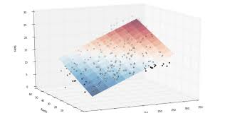
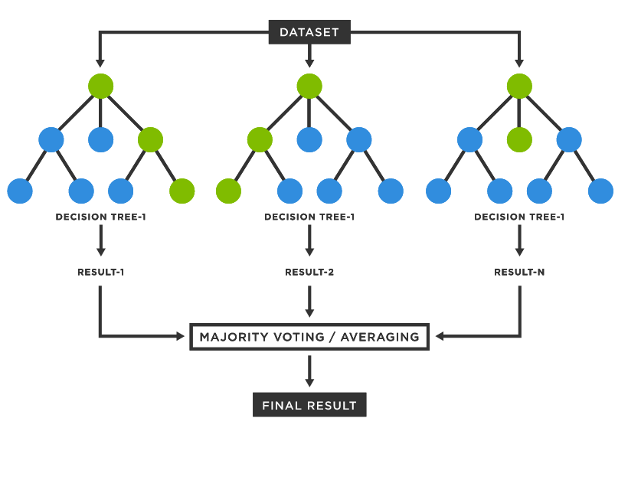
STAGE 2: ENSEMBLE THE DIFFERENT PERSPECTIVES
Train 7 different supervised learning models to predict the outcomes in the holdout dataset
X = The matrix of concatenated LSTM predictions
y = one of the outcomes (e.g., chooses, commits)
Ridge or Lasso
Use trained model to make predictions on the Dev and Test datasets using the concatenated data…you’ll use these predictions in Stage 3
Random Forests
USING DIFFERENT HOLDOUT DATASETS WITH LSTM PREDICTIONS
Notes:
We then trained a supervised learning model, like ridge regression, lasso regression, or a random forest, to predict the actual outcomes of the 296 cases, using the predicted outcomes from the different models.
Thus we can know what LSTM models seem to make good predictions of the outcome, and how to pool their information to get even better approximations of the outcome
After training this ensemble, we then use the ensemble to make predictions on the dev and test data

Slide 29
STAGE 2: ENSEMBLE THE DIFFERENT PERSPECTIVES
REPEAT PROCESS VARYING…
Number of SELECTED LSTMs: 15, 20, 25
Ensembler: Ridge, Lasso, Random Forest
Keep track of Dev Performance of Each Ensemble
USING DIFFERENT HOLDOUT DATASETS WITH LSTM PREDICTIONS
Notes:
We created different ensembles using different samples of trained LSTM models
We also vary the type of supervised learning method use to ensemble
For each ensemble we trained, we’ll submit its predictions to the dev leaderboard and keep track of its performance

Slide 30
We see an improvement when combining different perspectives
Dev Leaderboard performance varies between .42-.49 (better and more consistent than individual LSTMs), but vary between specific outcomes…
Some ensembles are better for some outcomes than others
Notes:
On the dev leaderboard, the ensemble models’ weighted correlation varies from .42 to .49. That would be good enough for anywhere between 15th and 3rd place.
Thus, these predictions are not only better than the individual models, but also more consistent
If you look at their performance outcome-by-outcome. They vary greatly though. Some ensemble are better for some outcomes than others

Slide 31
STAGE 3
COMBINE THE BEST PERFORMING ENSEMBLES
Notes:
The last stage is combining the different ensembles to take the best for a given outcome

Slide 32
STAGE 3: COMBINE THE BEST PERFORMING ENSEMBLES
Ensemble Name | Ensembler | Embed Models | LSTM Architecture | Commits Dev Performance | Chooses Dev Performance | … | Overall Dev Performance
Ensemble 1 | Random Forest | BERT, T5, XLM | Shallow | .42 | .41 | … | .50
Ensemble 2 | Ridge | BERT, T5, XLM | Shallow | .45 | .43 | … | .55
Ensemble 3 | Lasso | BERT, T5, XLM | Shallow | .43 | .49 | … | .61
Ensemble 4 | Random Forest | LaBSE, T5, BLOOM | Bidirectional | .48 | .44 | … | .49
…. | … | … | … | … | … | … | …
Ensemble 60 | Lasso | FLAN, T5, BART | Deep | .46 | .41 | … | .55
USING DEV BOARD PERFORMANCE
Notes:
We now have dozens of different ensemble, each with their own supervised learning method of ensembling, selection of embedding models, and LSTM architecture.
For each one of those, we also know the performance of it on the dev board for every outcome

Slide 33
STAGE 3: COMBINE THE BEST PERFORMING ENSEMBLES
Using the Dev Performance Scores
Pick an outcome (e.g., Commits)
Identify the best performing models for that outcome based on their dev score
USING DEV BOARD PERFORMANCE
USING DIFFERENT TEST DATASETS WITH ENSEMBLE PREDICTIONS
Notes:
For each outcome, we sorted all the ensembles by their performance on the dev leaderboard
We took the best 10 models for an outcome

Slide 34
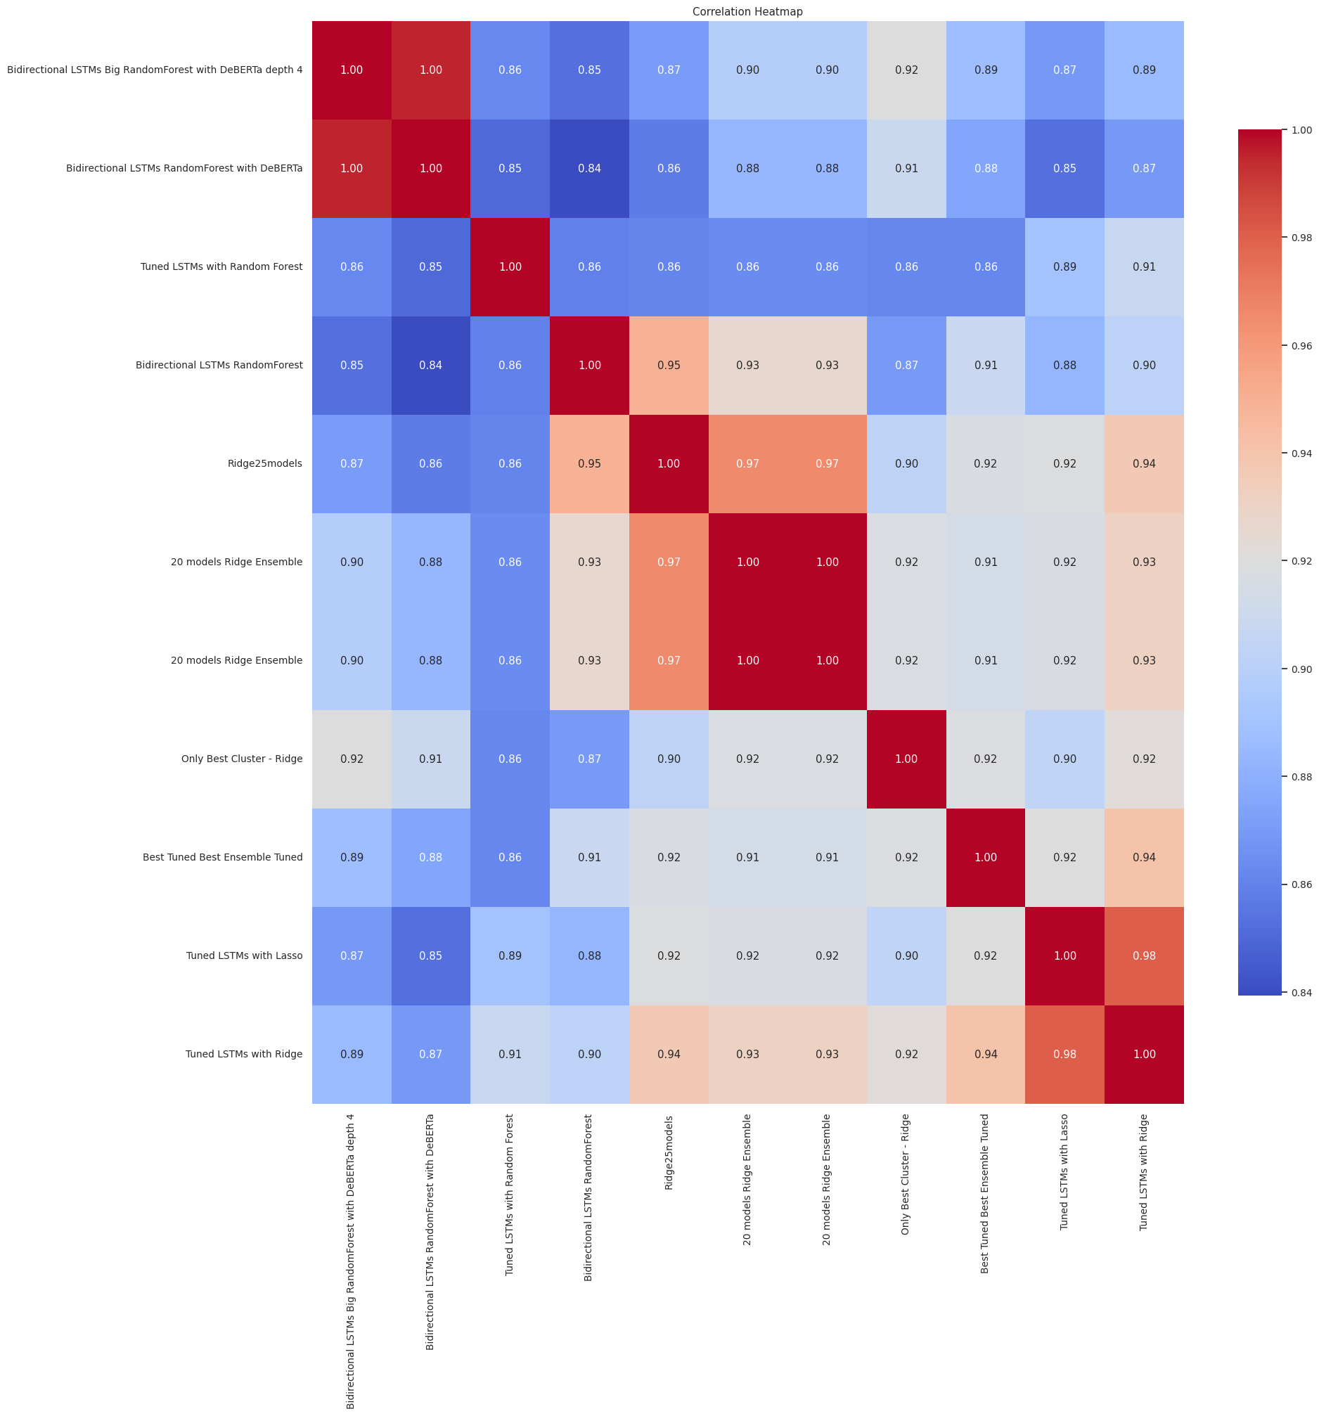
STAGE 3: COMBINE THE BEST PERFORMING ENSEMBLES
Examined correlation between best models’ predictions
Favored selecting ensemble models that were non-
overlapping
USING DEV BOARD PERFORMANCE
USING DIFFERENT TEST DATASETS WITH ENSEMBLE PREDICTIONS
Notes:
Next, we examined the correlation between the dev data predictions made by each of the best 10 ensembles
We see that some ensembles are redundant (indicated by clusters in the heatmap above), while others are just as good, but provide unique information
We take the best 4-5 models that are non-overlapping

Slide 35
STAGE 3: COMBINE THE BEST PERFORMING ENSEMBLES
Best Chooses Models
Ensemble 1
Ensemble 5
Ensemble 22
Ensemble 28
Best Commits Models
Ensemble 4
Ensemble 2
Ensemble 29
Ensemble 37
Best Gathers Models
Ensemble 18
Ensemble 19
Ensemble 31
Ensemble 53
Avg These Predictions
Avg These Predictions
Avg These Predictions
We can incorporate other models that performed well during Dev phase too
Best Gathers Models
DeBERTa
Ensemble 29
Ensemble 46
Ensemble 33
Best Identifies Models
Ensemble 4
Ensemble 20
Ensemble 29
Ensemble 52
Best Involves Models
Ensemble 4
Ensemble 20
Ensemble 28
Ensemble 43
Best Overall Models
Ensemble 17
Ensemble 23
Ensemble 33
Ensemble 47
Avg These Predictions
Avg These Predictions
Avg These Predictions
Avg These Predictions
USING DIFFERENT TEST DATASETS WITH ENSEMBLE PREDICTIONS
Notes:
Now we have a collection of strong independent ensembles for each outcome. We then have each ensemble make predictions on the test data and average those predictions
We then submit the average of those predictions to the test leaderboard
This step also allows us to incoporate other models we used, like DeBERTa that also performed well on the dev data for some outcomes

Slide 36
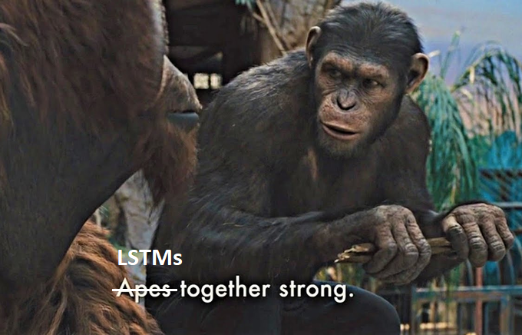
We see further improvement when combining ensembles
Dev Leaderboard performance varied between .49-.52 (higher and more consistent than single ensemble models)
Test Leaderboard performance varied between .49-.52
Notes:
This ensemble of ensembles provides even stronger performance on the dev data ranging between .49 and .52, which is higher and more consistent than single ensemble models
On the test leaderboard, it performs identically well and just as consistently.
Thus, while LSTMs may seem weak individually, when trained to capture different perspectives, and then ensembled to maximize the unique information they provide, they can be quite strong.

Slide 37




Thanks!
Andrew Cutler
Ivan Hernandez
Joe Meyer
Weiwen Nie
Notes:
Thank you again Isaac, Nick, Sebastian, and Georgi for organizing as well as DDI for providing the data.
You always create competitions that have unique twists and advance our field in different ways, with how they are solved.
I appreciate the opportunity to be on stage with so many great machine learners to share these insights on approaches to new problems.

